Slide 1
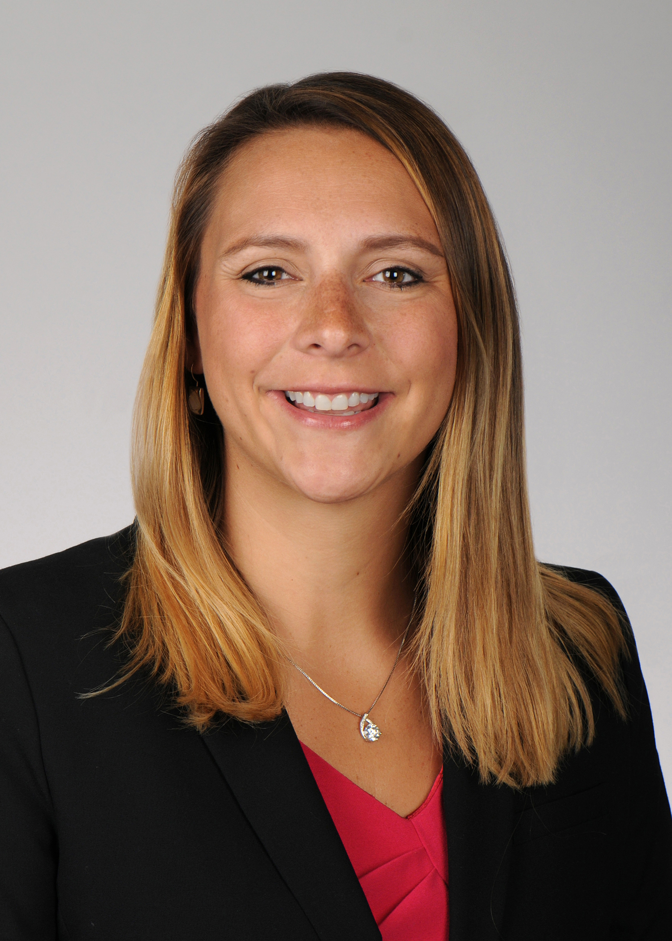
Annual Meeting
Friday, September 22, 2023
10:00am – 2:00pm
The Charleston Center
3685 Rivers Ave
Training Room - 2C03 (2nd floor)
North Charleston, SC 29405
Guest Speaker: Tracy Smith, PhD – Associate Professor - MUSC
Topic: Research to inform tobacco regulation: moving people down the continuum of harm

